Slide 1
NCR’S PAY LATER
A BNPL solution for hassle free transactions
Project Fourth Wave

Slide 2
Index
Problem Statement
Proposed Solution
Functionality Flow/System Design
Using Our Solution
Matrix co-relation
Tech Stack
Future Scope I
Future Scope II
Team

Slide 3
Problem Statement
Many a times, the shopper finds themselves in a difficult situation during the payment phase of a transaction.
They maybe over the budget in some cases, cards being declined, bank server issues, not carrying enough cash, the SCO not having enough cash to dispense change & many more.
Normally, the payment process takes around ~10-15 seconds per transaction, which again be prone to multiple card errors or cash management failures.
An average of 1000 transactions if done on a particular day at a store, sums to ~15000 seconds i.e ~4hrs.
This ~4hrs per store, among many in a city, a great deal of time can be saved by introducing a simple payment design, which will have both the customer & retailer at a happy place.
All the payment related issues which exists, can be steered away with NCR’s Pay Later.

Slide 4
Solution
NCR's Pay Later allows the payments/billings to be done differently than in a traditional way, by allowing the customer to purchase the products, thus completing the transaction, and paying the amount later.
A new feature Pay Later is introduced in the payment/tender screen. This button allows the shopper to complete the transaction without paying for the transaction at the moment.
The current transaction amount will be added to the shopper’s(loyalty account holder) Pay Later account, which is maintained & managed by the Retailer, thus by NCR.
This amount can be paid later by the shopper, either as an EMI whose regulations are written & explained by the Retailer or can be paid as a lump sump within a defined time frame again regulated by the Retailer.
Prerequisites :
The customer. must already be a loyalty member of the Retailer.
His/her bank details, credit card details securely stored with the Retailer to use our Pay Later feature.
The shopper opting the Pay Later configurations like EMI time period, payment due expiry etc. which will be discussed further

Slide 5
System Design/Architecture
By Project Fourth Wave

Slide 6
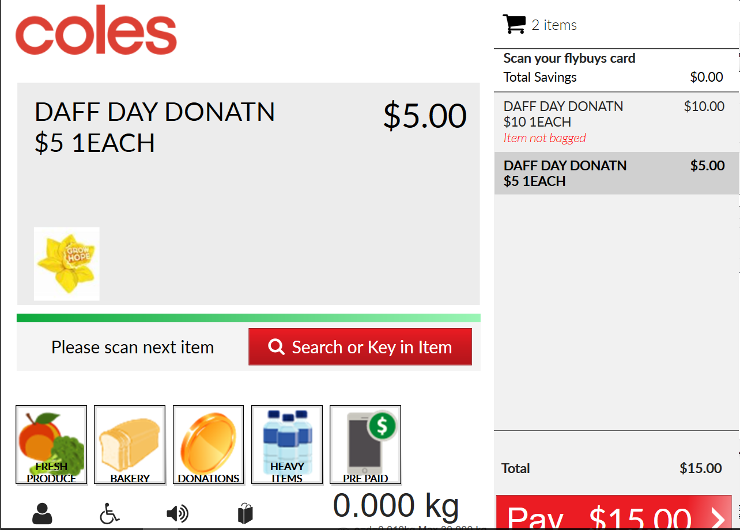
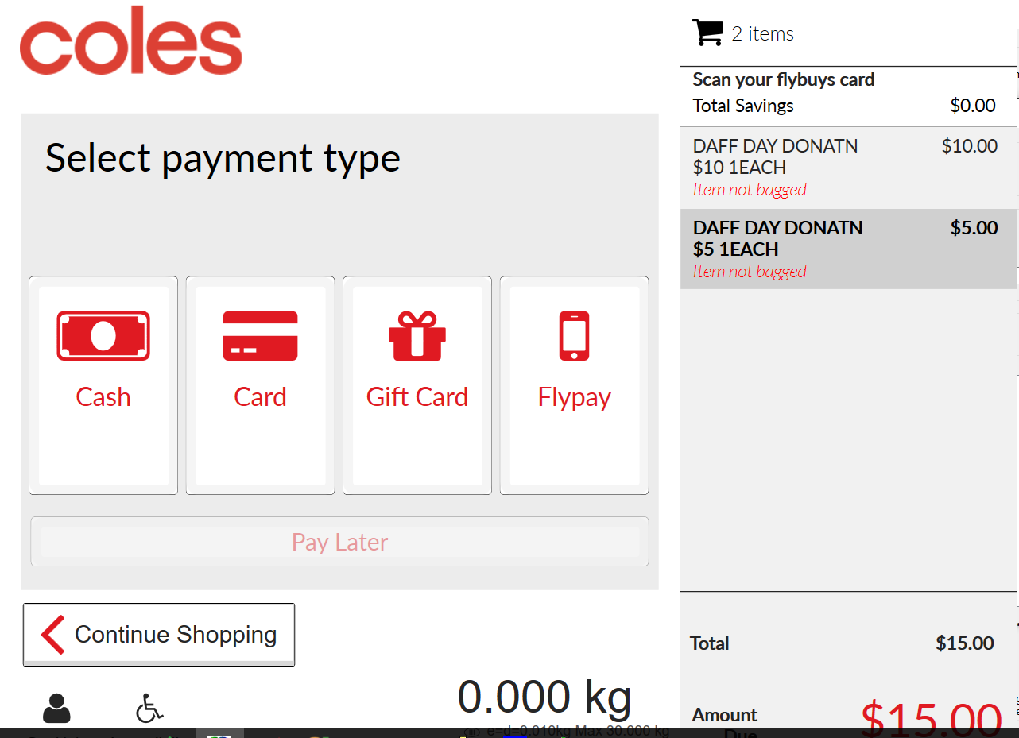


System Design
Loyalty not scanned
Loyalty scanned
#1
#2
NCR Confidential

Slide 7
System Design
#1
Scenario 1: Loyalty Not Scanned
Start: Shopper enters the store, shops & starts a transaction at our lane
Step 1: The shopper starts scanning the items at the Scan&Bag screen
Step 2: The shopper clicks on Pay and enter the payment/tender mode
Step 3: The Pay Later button is observed to be disabled. The Shopper decides not to scan the loyalty card, thus not enabling the Pay Later feature.
Step 4: The shopper completes the transaction with any of the mode of payments available
Step 5 : The SCO moves to ThankYou screen, the shopper takes the items & completes the transaction

Slide 8
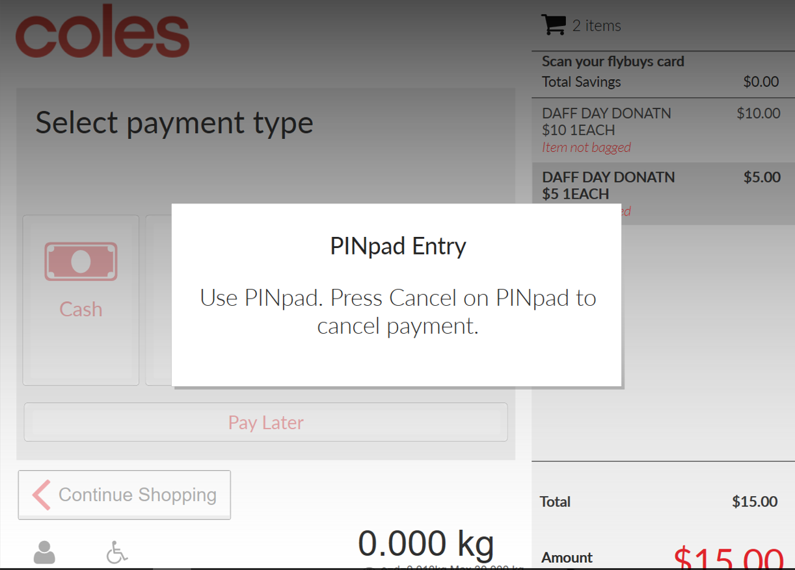
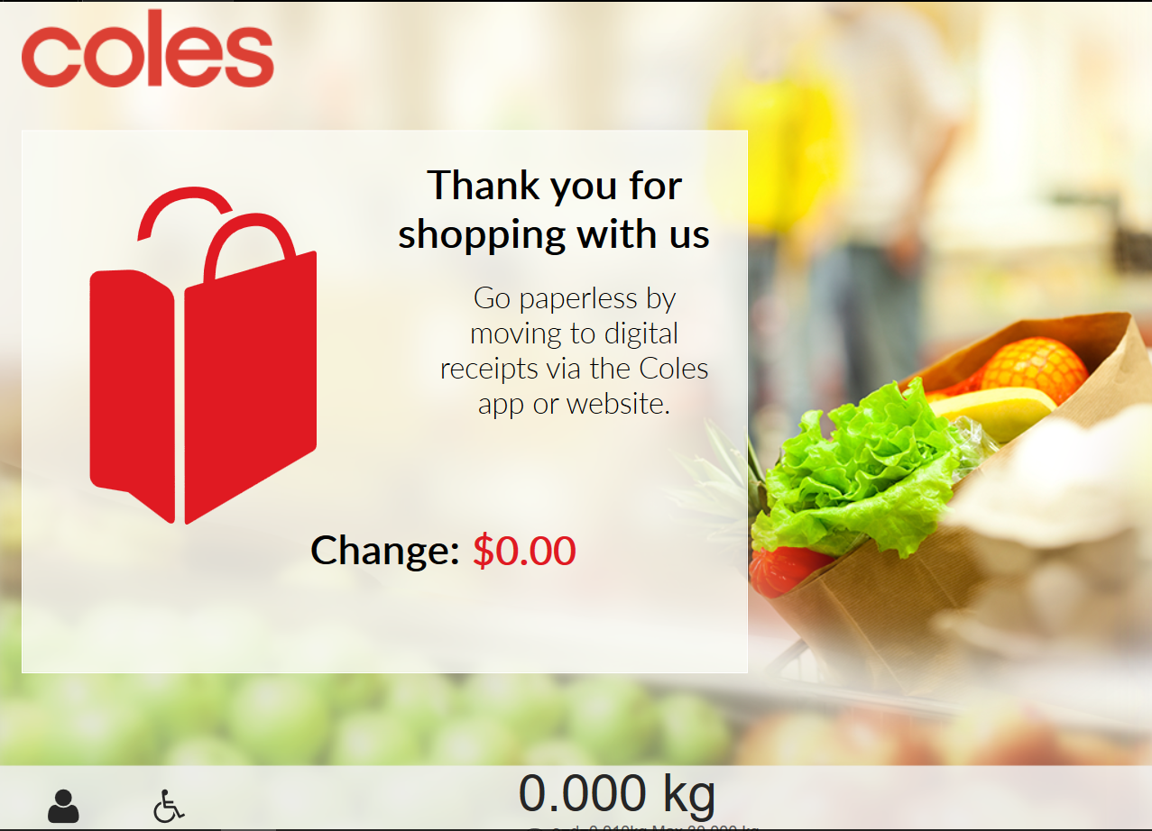
System Design
#1
Payment Processing
Card/EPS payment clicked
ThankYou Screen

Slide 9

Using Our Solution
#2
Scenario 2: Loyalty Scanned – starting from the point shopper enters payment screen
Step 1: The Pay Later button is disabled by default. The shopper scans the loyalty card
Step 2: The Loyalty Card is added to the transaction, the Pay Later button is now enabled
Step 3: The shopper clicks on the Pay Later button. At the backend the SCO communicates with the server, which in-turn transacts with the bank of the shopper, whose info are received from the loyalty card details.
Step 4 : The server confirms on the eligibility if shopper has configured the Pay Later feature
Step 5 i: If Yes, the details are shown on the SCO, the amount has been successfully added to the due amount to be paid & updated to the server. The shopper completes the transaction
Step 5 ii: If No, the shopper is redirected to the payment screen, the transaction is completed with traditional payment options available

Slide 10
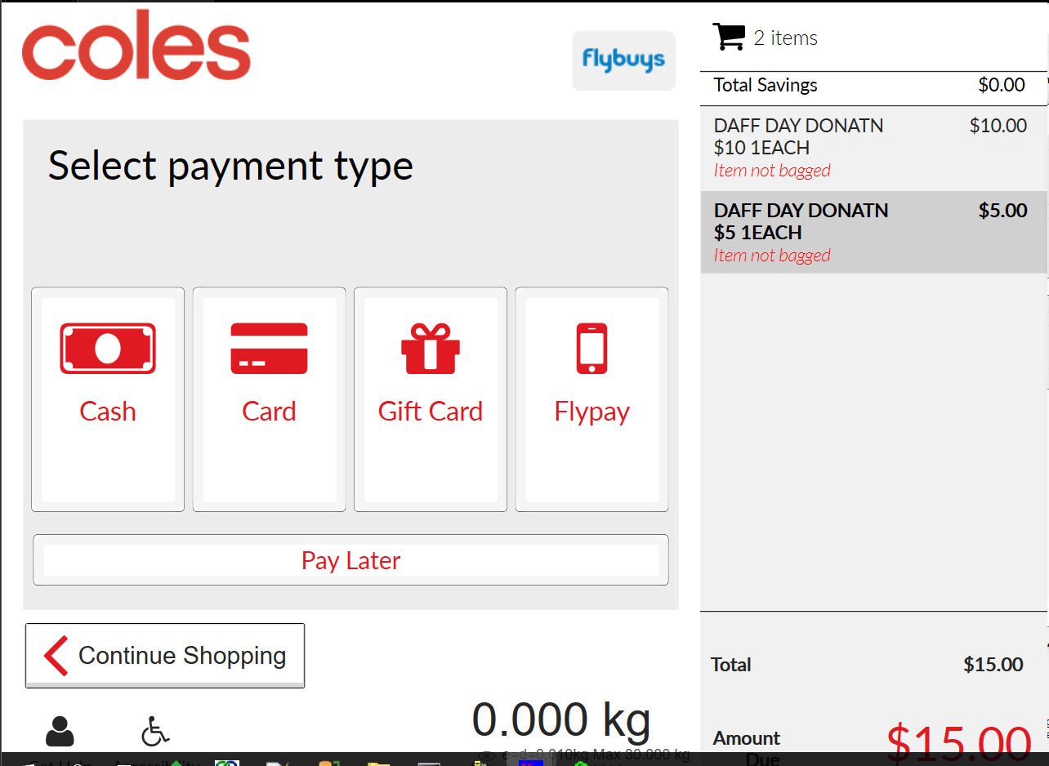
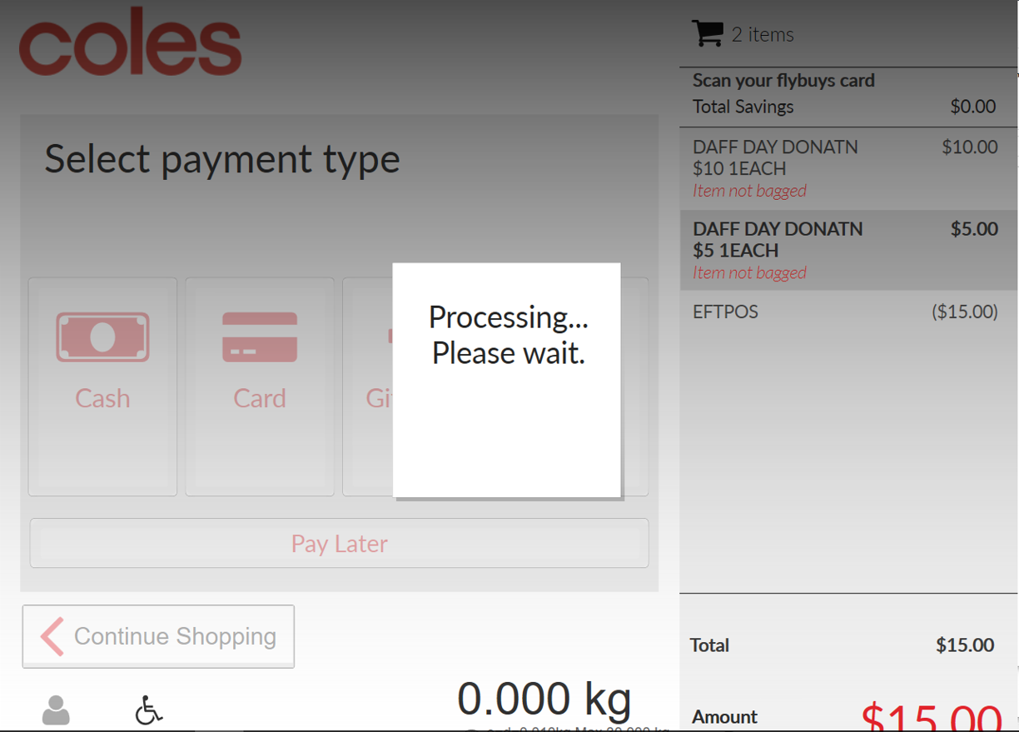

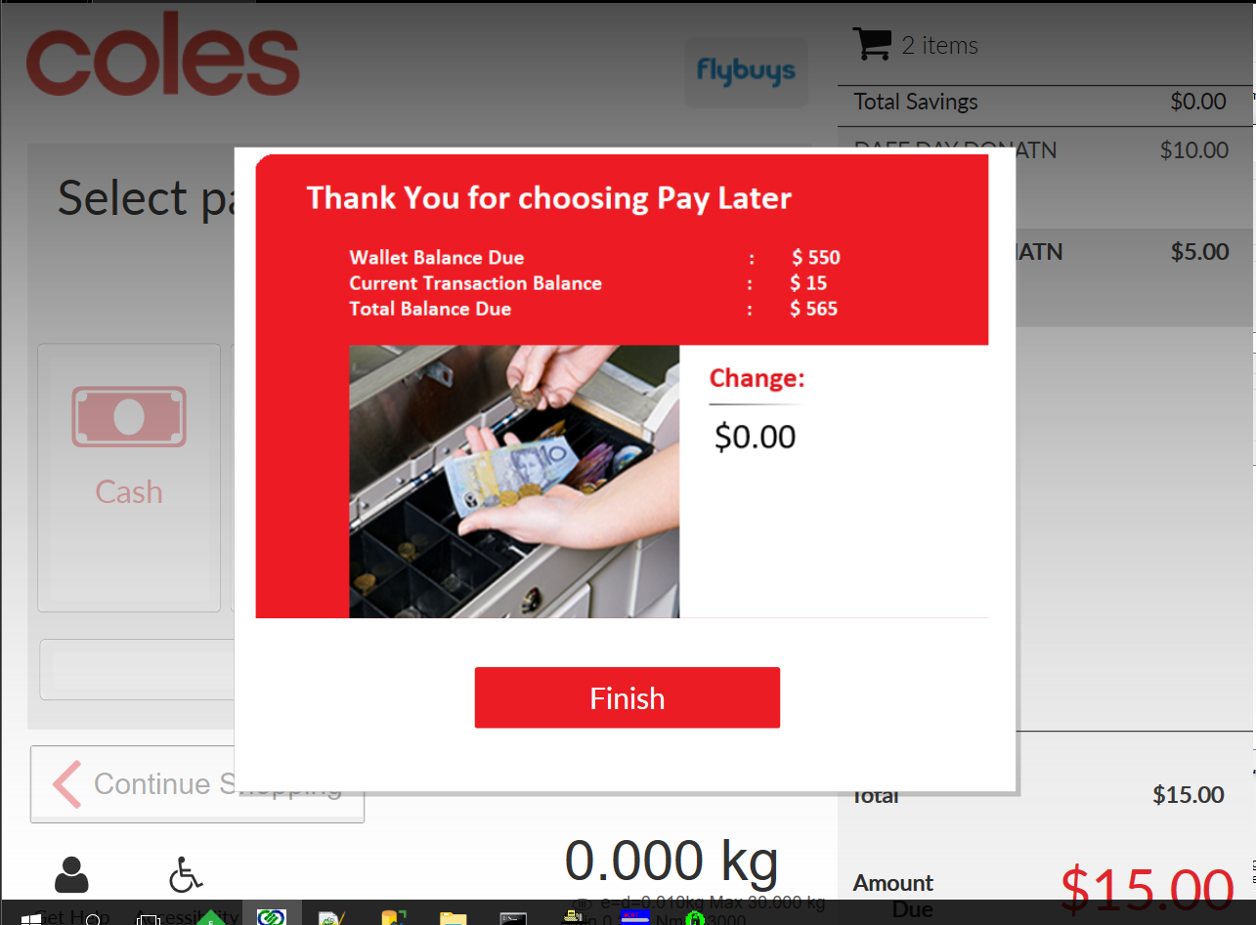


Using Our Solution
#2
Checking eligibility of the shopper to use Pay Later
Pay Later clicked
NO
Redirects to Tender screen
YES

Slide 11
Using Our Solution
Final Screen Look

Slide 12
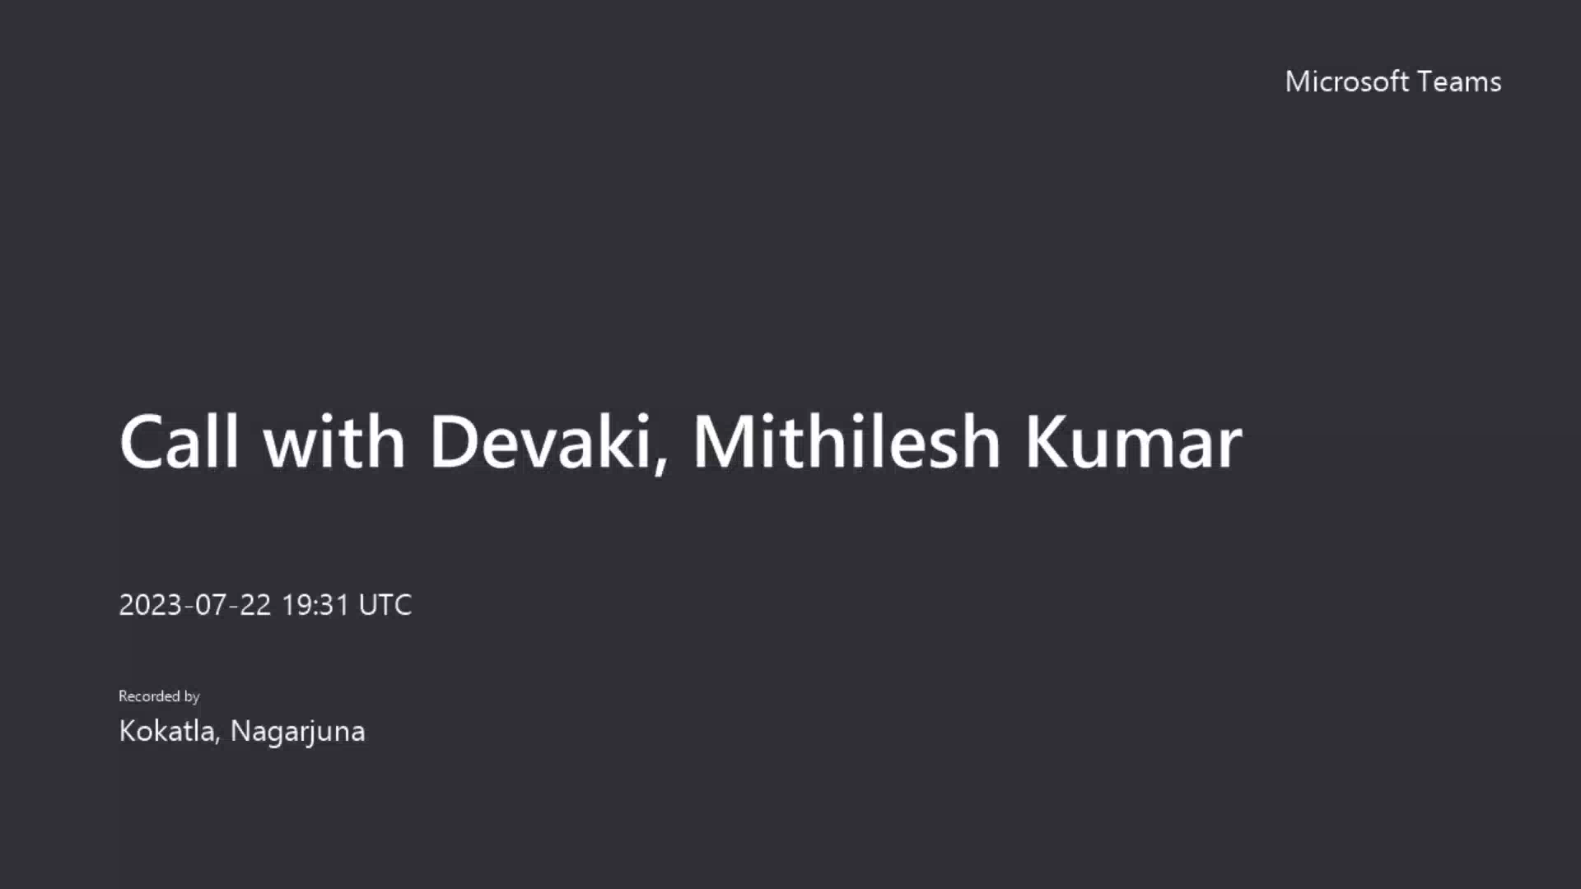
Prototype/Demo

Slide 13
A Matrix co-relation: With/without our Solution
Dimension | Present scenario | Adding PayLater Feature
Flexibility | Customers might have to deal with difficulties such as : Limited Budget constraints Cards being declined. Not carrying enough cash. | PayLater provides great flexibility by allowing customers to buy products at the moment and pay at their convenience with ease.
Time | Customers have to bear with the waiting time in case of payments with cards such as server latency issues, otp etc. | The waiting time of 10 to 15 seconds is eliminated for the customer.
Speed (No. of transactions made per day) | The waiting time badly affects the speed/no. of transactions that can be made per day. | The speed/no. of transactions made per day can be greatly increased as the waiting time is eliminated.

Slide 14
Tech Stack
FrontEnd :
WPF
XAML, XML, .NET, EJS
BackEnd :
C#
C++
NodeJS
Notes:
2. The Launchpad includes a button for
5. showing likelihood of working for similar issues in future.
6. Capability To Create Jira Automatically

Slide 15
Future Scope I
Prerequisite – Pay Later feature is implemented where in the bank details of a customer are being associated with their Loyalty account.
As the retailer loyalty accounts of customers has the bank details of the customer, there is a scope to introduce an investment option enabling customers to opt paying an extra amount adding up to the total transaction amount if they are willing to invest.
The idea is to develop a Rounding feature where in the customer will be given the choice of opting to pay from a few nearly rounded values of the original transaction amount.
If the customer opts to pay the rounded amount, the extra amount that has been added to the original transaction can be made use in two ways:
Adding them as Loyalty Points with the associated loyalty card.
Adding them to investment account provided by the card holder.
Notes:
2. The Launchpad includes a button for
5. showing likelihood of working for similar issues in future.
6. Capability To Create Jira Automatically

Slide 16
Future Scope II
In a general real-world scenario, different customers hold accounts in the banks of their own choice.
In cases where the customer opts to pay his/her pay later balance due through monthly installments, the application should be able to support EMI transactions done from several bank accounts.
So, as a solution to address the above use case, an integration layer can be built which can authorize a customer and the details of the bank the customer is associated with, in addition to providing the ability to accept payments/EMI installments from multiple banks
Notes:
2. The Launchpad includes a button for
5. showing likelihood of working for similar issues in future.
6. Capability To Create Jira Automatically

Slide 17


Project Fourth Wave
Mithilesh Kumar Devaki
GPS SCO Developer
Kokatla Nagarjuna
PS Engineer I

Slide 18
THANK YOU
Project Fourth Wave

